Slide 1
Introduction
— Chapter 1
2021年9月
叶文
yewen@bupt.edu.cn
School of Computer Science (National Pilot Software Engineering School)

Slide 2
Outline
DB行业应用，采用DB管理数据的必要性（与文件的区别）
Database System Applications
Purpose of Database Systems
View of Data
Database Languages
Database Design
Database Engine
Database Application and Architecture
Database Users and Administrators
History of Database Systems
Database Products&Markets
DB存储管理数据的原理、规范、模式
访问DB数据的interface
按照DB规范（数据模型），设计数据在DB中的组织方式
使用DBMS，存储访问数据库中数据
数据库应用系统体系结构
访问和管理DB的users
背景知识

Slide 3
Concepts: DB, DBMS, DBS, DBAS
Definitions in the textbook
Database (DB)
a collection of interrelated data
stored in systems as files
Database management system (DBMS), consisting of
DB, or a collection of interrelated data
a set of programs to access the data in DB
Database system (DBS)
having the same definition as DBMS in the textbook
the term DBS and DBMS are used interchangeably in the textbook
Database systems are used to manage collections of data that are:
Highly valuable
Relatively large
Accessed by multiple users and applications, often at the same time
DBMS provides an environment that is both convenient and efficient for store and retrieve information
definition of structures for storage of information
data manipulation mechanisms
data safety mechanisms

Slide 4
Concepts: DB, DBMS, DBS, DBAS
Definitions in other textbooks
Database(DB)
a collection of interrelated data , stored in systems as files
Database management system (DBMS)
a system/mechanism to manage data in DB
or: set of programs to access the data in DB
Database system(DBS)
DB + DBMS + Users/Administers
Database application system
DB + DBMS + Application programs + Users/Administers
application program 1
API, e.g.ODBC, JDBC
DB file
application program 2
DBMS
e.g.openGauss
…
database language
e.g. SQL
Users
DBMS
DB
DBS/DBAS
Fig.1.0.1 DBS and DBAS

Slide 5
1.1 Database Applications
A modern database system is a complex software system whose task is to manage a large, complex collection of data with various forms and structures
Databases touch all aspects of our lives
Enterprise Information
Sales: customers, products, purchases
Accounting: payments, receipts, assets
Human Resources: Information about employees, salaries, payroll taxes.
Manufacturing: management of production, inventory, orders, supply chain.
Banking and finance
customer information, accounts, loans, and banking transactions.
Credit card transactions
Finance: sales and purchases of financial instruments (e.g., stocks and bonds; storing real-time market data

Slide 6
Database Applications Examples (Cont.)
Universities: registration, grades
Airlines: reservations, schedules
Telecommunication
records of calls, texts, and data usage, generating monthly bills, maintaining balances on prepaid calling cards
Web-based services
Online retailers: order tracking, customized recommendations
Online advertisements
Document databases
e.g. MongDB
Navigation systems: For maintaining the locations of varies places of interest along with the exact routes of roads, train systems, buses, etc.

Slide 7
1.2 Purpose of Database Systems
In the early days, database applications were built directly on top of file systems, which leads to:
Data redundancy and inconsistency
data is stored in multiple file formats resulting induplication of information in different files
Difficulty in accessing data
Need to write a new program to carry out each new task, by using file access API
Data isolation
Multiple files and formats
Integrity problems
Integrity constraints (e.g., account balance > 0) become “buried” in program code rather than being stated explicitly
Integrity: semantic constraints
Hard to add new constraints or change existing ones

Slide 8
Purpose of Database Systems
Atomicity of updates
Failures may leave database in an inconsistent state with partial updates carried out
Example: Transfer of funds from one account to another should either complete or not happen at all
Concurrent access by multiple users
Concurrent access needed for performance
Uncontrolled concurrent accesses can lead to inconsistencies
Ex: Two people reading a balance (say 100) and updating it by withdrawing money (say 50 each) at the same time
Security problems
Hard to provide user access to some, but not all, data
Database systems offer solutions to all the above problems

Slide 9
Why DB needed
access through
I/O ports
access through
OS file system
access through
DBS
access programs III
access programs I
access programs II
DBS API
DBMS: relational tables’ logical
structures and access methods
system calls related
to file management
file system:
file’s logical structures and access methods
I/O system : drivers
memory controllers (i.e. disk controller),
based on secondary storage’s physical structures, such as storage structures, access method
secondary storage (e.g. disk, tape)
and data on disk (address: cylinder, track, sector)

Slide 10
University Database Example in the textbook
In this text we will be using a university database to illustrate all the concepts
Data consists of information about:
Students
Instructors
Classes
Application program examples
Add new students, instructors, and courses
Register students for courses, and generate class rosters
Assign grades to students, compute grade point averages (GPA) and generate transcripts

Slide 11
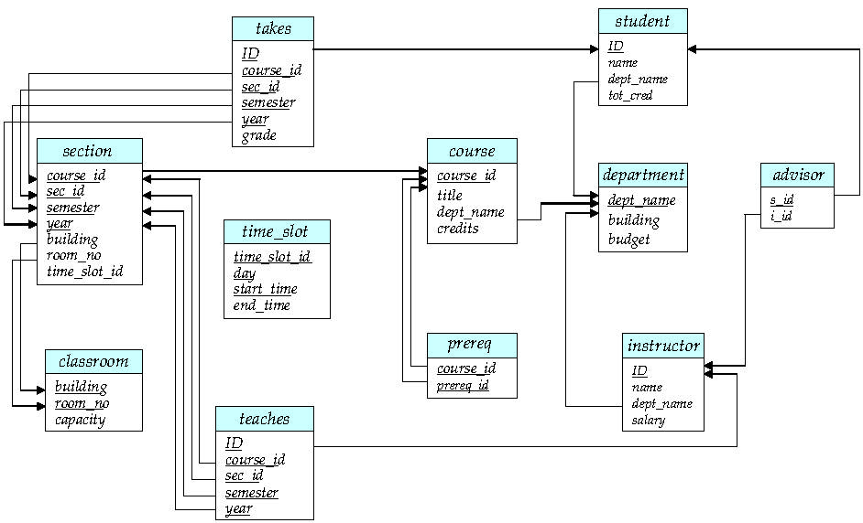
11 tables in University database，
relational schemas
Case study used in this chapter

Slide 12

Section
课表中上课时段

Slide 13
1.3 View of Data
A database system is a collection of interrelated data and a set of programs that allow users to access and modify these data.
A major purpose of a database system is to provide users with an abstract view of the data.
data models
a collection of conceptual tools for describing:
data, data relationships,
data semantics, and consistency constraints
specifications for data organization and access
data modeling
organize application data in the database, according to data model, by data abstraction
data abstraction
database modeling mechanism
hide the complexity of data structures to represent data in the database from users through view-logical-physical levels of data abstraction
integrity constraints

Slide 14
Data Model
Definition of data model
DBS中对数据组织与管理/使用方式的抽象描述，包括
数据组织的语法定义，如数据项、数据项间的联系
数据组织的语义定义，如完整性约束
数据操作 (note: only in some data models, e.g. relational data model)
程序 = 数据结构 + 算法
Relational model
Entity-Relationship data model (mainly for database design)
Object-based data models (Object-oriented and Object-relational)
Semi-structured data model (XML)
Other older models:
network model, hierarchical model
图模型

Slide 15
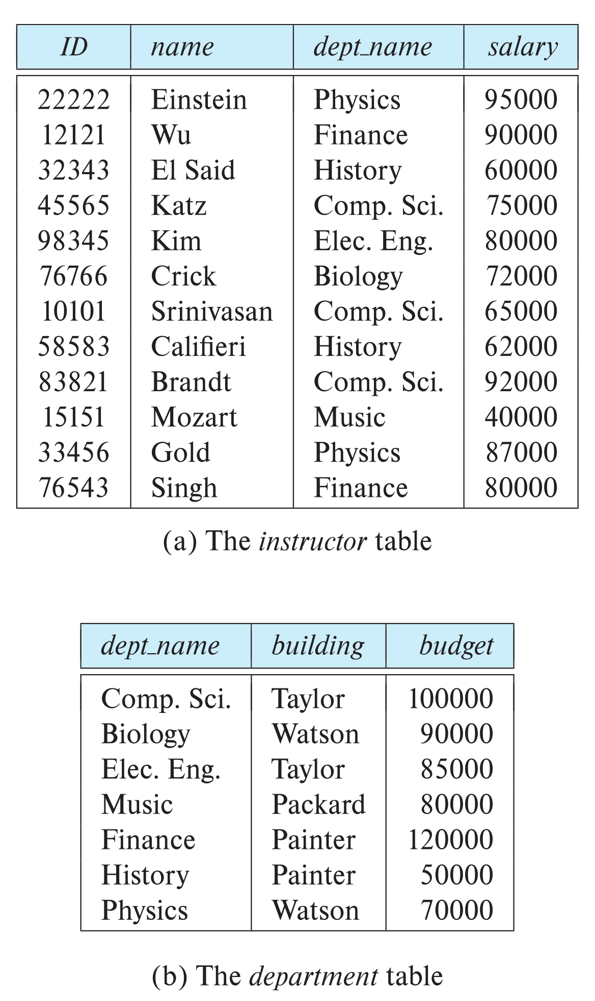

Relational Model
Classical and widely-used data model
All the data is stored in various tables
proposed by Codd
Example of tabular data
Columns
Ted Codd Turing Award 1981
Rows
one of four Turing Award Winners in the fields of databases

Slide 16
Levels of Abstraction
Physical level
describes how a record (e.g., instructor) is stored.
Logical level
Implementation/DB-oriented
describes data stored in database, and the relationships among the data.
type instructor = record
ID : string; name : string; dept_name : string; salary : integer;
end;
外模式
逻辑模式
物理模式/
内模式
View level
application programs hide details of data types
views can also hide information (such as an employee’s salary) for security purposes.

Slide 17
Levels of Abstraction
View level
application programs hide details of data types
views can also hide information (such as an employee’s salary) for security purposes
described as Entity-relationship (E-R) diagrams
E.g. University database
more than one viewpoints, for a data object
view₁: student<id, name>
view₂: student<id, dept_name>
view₃: student<id, tot_cred>

Slide 18
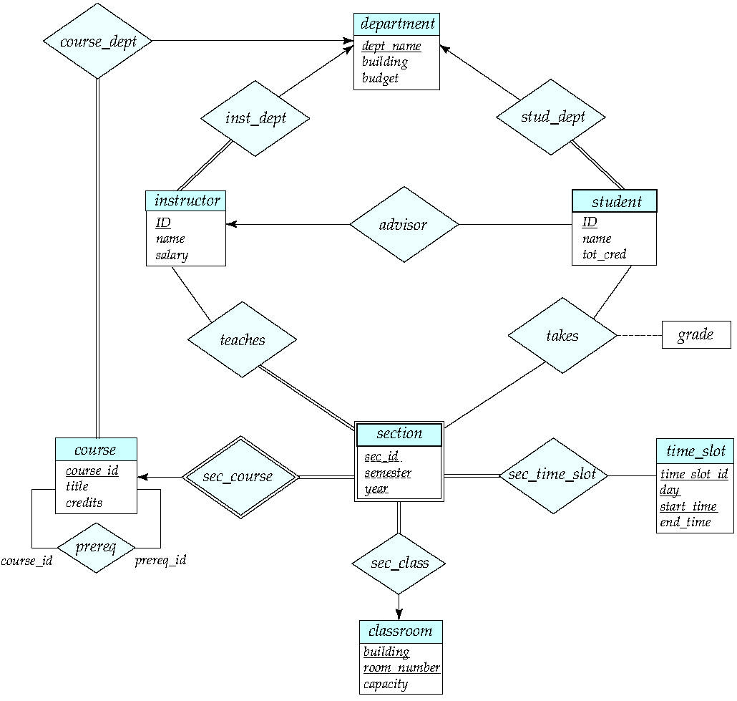
E-R diagram
18

Slide 19
Model, Schemas, Instances
Data modeling, in line with data models, produces data schemas(模式), including the logical and physical schema, which describe the organization of data in database
Logical Schema – the overall logical structure of the database
Example: The database consists of information about a set of customers and accounts in a bank and the relationship between them
analogous to type information of a variable in a program
Physical schema – the overall physical structure of the database
e.g how data is stored in database file, and how to access the database file
DB Instance – the actual content of the database at a particular point in time
analogous to the value of a variable
Model vs schemas vs instance
similar to types, variables and values of variables in programming languages
int x = 0

Slide 20
Model, Schemas, Instances
E.g.
relational data model
R={<a₁, a₂, …., a_{n}> }
relational data schema
instructor=<ID, name, dept_name, salary>
instance of schema
<2222, Einstein, Physics, 95000>

Slide 21
Data Independence
Independence between data uses/application programs and data in DBS
Logical data independence
when DBS’s logical schemas at logical level (DBMS-oriented) change, application-oriented external schema or application programs do not change
e.g.
student=<id, name, dept_name, tot_cred>
is extended into
student=<id, name, age, dept_name, tot_cred>,
or changed into
student=<sid, sname, age, dept_name, tot_cred>
Physical data independence
application programs do not depend on DBS’s physical schemas
i.e. when physical schemas such as index, storage location, DB file and block-size change, application programs remain unchanged
the ability to modify the physical schema without changing the external/logical schemas, on which application programs depend

Slide 22
Data Independence
逻辑模式→内模式间的映射与physical data independence
物理存储发生变化，调整逻辑模式→内模式间的映射，保证逻辑模式不变，应用程序尽可能不变
由DBMS提供
外模式→逻辑模式间的映射与logical data independence
数据逻辑结构发生变化，如关系表发生变化，调整外模式→逻辑模式间的映射，保证外模式不变，从而应用程序尽可能不变
应用程序基于外模式访问数据库
用户A₁
用户A₂
用户B₁
用户B₂
宿主语言
+ DML
宿主语言
+ DML
宿主语言
+ DML
宿主语言
+ DML
外模式
外部视图A
外部视图B
外模式-逻辑模式映射
逻辑模式
DBMS
逻辑-物理模式映射
内/物理模式
Fig.1.0.4

Slide 23
1.4 Database Language: Data Definition Language (DDL)
Specification notation for defining the database schema
Example: create table instructor ( ID char(5), name varchar(20), dept_name varchar(20), salary numeric(8,2))
DDL compiler generates a set of table templates stored in a data dictionary
Data dictionary contains metadata (i.e., data about data)
Database schema
Integrity constraints
Primary key (ID uniquely identifies instructors)
Authorization
Who can access what

Slide 24
Database Language: Data Manipulation Language (DML)
Language for accessing and updating the data organized by the appropriate data model
DML also known as query language
There are basically two types of data-manipulation language
Procedural DML -- require a user to specify what data are needed and how to get those data.
Declarative DML -- require a user to specify what data are needed without specifying how to get those data.
Declarative DMLs are usually easier to learn and use than are procedural DMLs.
Declarative DMLs are also referred to as non-procedural DMLs
The portion of a DML that involves information retrieval is called a query language.

Slide 25
Database Language: SQL Query Language
SQL query language is nonprocedural. A query takes as input several tables (possibly only one) and always returns a single table.
Example to find all instructors in Comp. Sci. dept
select name from instructor where dept_name = 'Comp. Sci.'
SQL is NOT a Turing machine equivalent language

Slide 26
Database Language: Database Access from Application Program
To be able to compute complex functions SQL is usually embedded in some higher-level language
Application programs generally access databases through one of
Language extensions to allow embedded SQL
Application program interface (e.g., ODBC/JDBC) which allow SQL queries to be sent to a database
Non-procedural query languages such as SQL are not as powerful as a universal Turing machine.
SQL does not support actions such as input from users, output to displays, or communication over the network.
Such computations and actions must be written in a host language, such as C/C++, Java or Python, with embedded SQL queries that access the data in the database.
Application programs -- are programs that are used to interact with the database in this fashion.

Slide 27
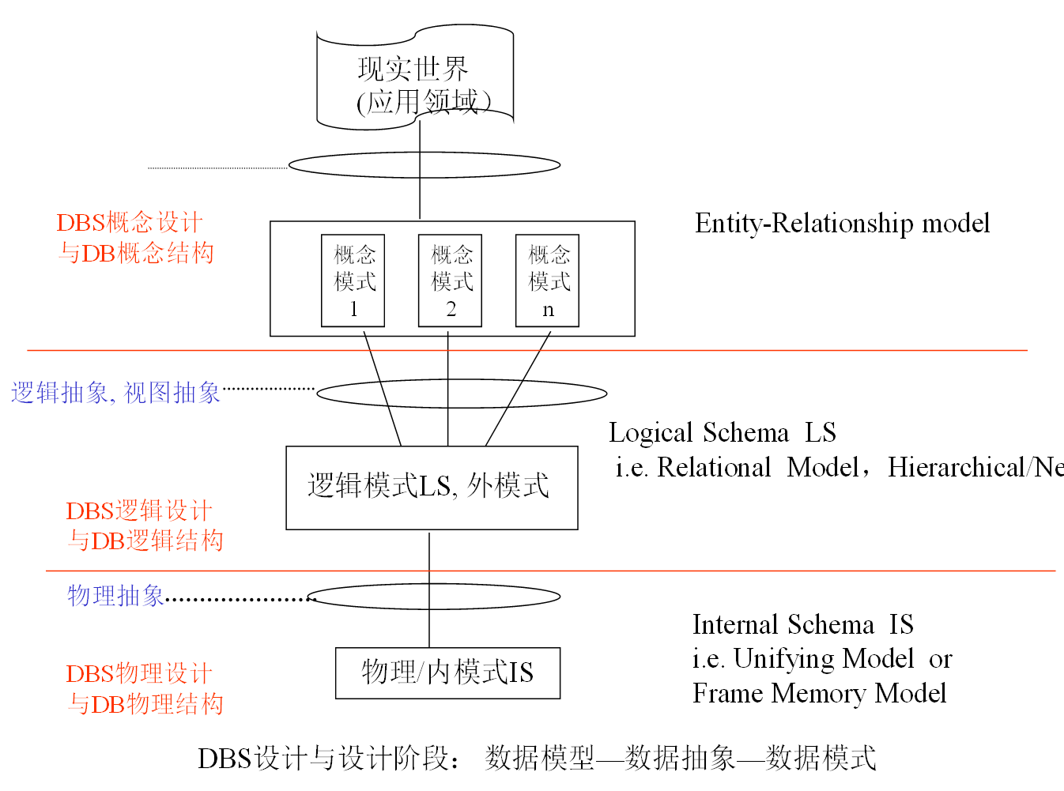
1.5 Database Design
从保持data independence角度出发，根据data models所定义的数据规范形式，在view、logical 、 physical三个层次，通过data abstraction，经过概念设计、逻辑设计、 物理设计三个步骤，构造 面向具体应用领域的DBS的 E-R diagrams, external schema/logical schema , internal schema的集合, 得到conceptual DB 、logical DB 、physical DB设计结果
As described in Fig.1.0.6
conceptual design
logical design
physical design

Slide 28
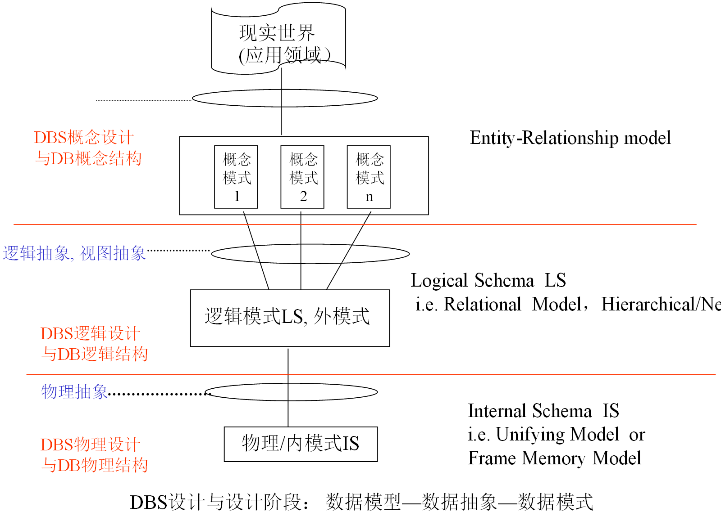
1.5 Database Design
从保持data independence角度出发，根据data models所定义的数据规范形式，在view、logical 、 physical三个层次，采用data abstraction，通过DB概念设计、逻辑设计、 物理设计三个阶段，构造 面向具体应用领域的DBS的 E-R diagrams, external schema/logical schema , internal schema的集合, 得到conceptual DBS 、logical DBS 、physical DBS的设计结果
As described in Fig.1.0.6
conceptual design
logical design
physical design
Notes:
28

Slide 29
Database Design
Logical Design
deciding on the database schema. Database design requires that we find a “good” collection of relation schemas.
Business decision – What attributes should we record in the database?
Computer Science decision – What relation schemas should we have and how should the attributes be distributed among the various relation schemas?
Physical Design
deciding on the physical layout of the database
depend on DBMS platform

Slide 30
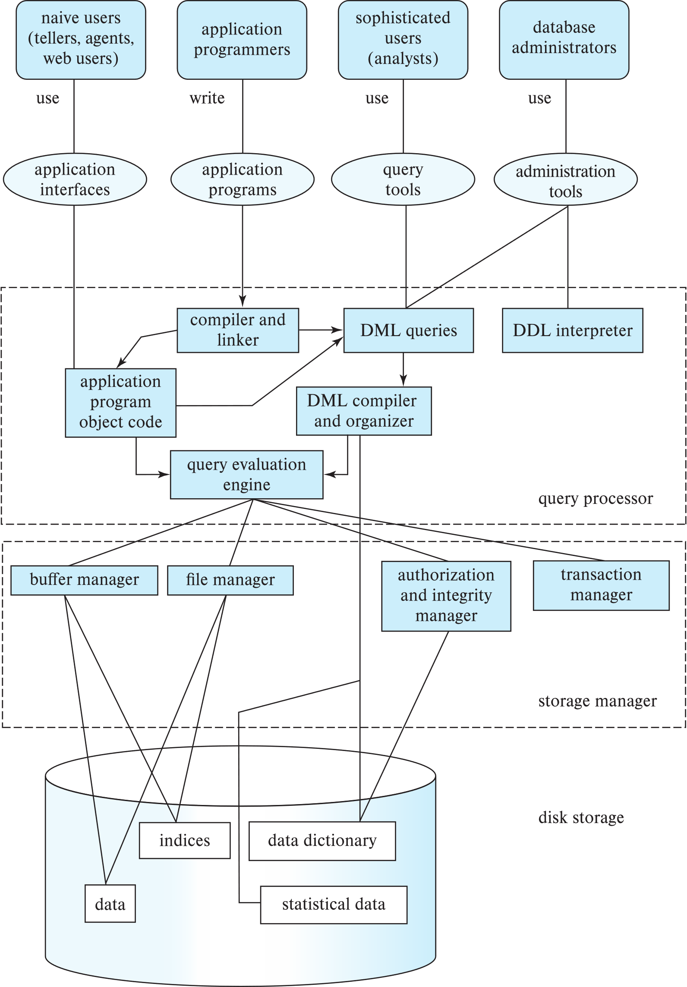
1.6 Database Engine/DBMS
A database system is partitioned into modules that deal with each of the responsibilities of the overall system.
The functional components of a database system can be divided into
query processor component
storage manager
transaction management component

Slide 31
Storage Manager
A program module that provides the interface between the low-level data stored in the database and the application programs and queries submitted to the system.
The storage manager is responsible to the following tasks:
Interaction with the OS file manager
Efficient storing, retrieving and updating of data
The storage manager components include:
Authorization and integrity manager
Transaction manager
File manager
Buffer manager
The storage manager implements several data structures as part of the physical system implementation:
Data files -- store the database itself
Data dictionary -- stores metadata about the structure of the database, in particular the schema of the database.
Indices -- can provide fast access to data items. A database index provides pointers to those data items that hold a particular value.

Slide 32
Query Processor
The query processor components include:
DDL interpreter -- interprets DDL statements and records the definitions in the data dictionary.
DML compiler -- translates DML statements in a query language into an evaluation plan consisting of low-level instructions that the query evaluation engine understands.
The DML compiler performs query optimization; that is, it picks the lowest cost evaluation plan from among the various alternatives.
Query evaluation engine -- executes low-level instructions generated by the DML compiler.

Slide 33
Transaction Management
A transaction is a collection of operations that performs a single logical function in a database application
Transaction-management component ensures that the database remains in a consistent (correct) state despite system failures (e.g., power failures and operating system crashes) and transaction failures
Concurrency-control manager controls the interaction among the concurrent transactions, to ensure the consistency of the database.

Slide 34
1.7 Database Architecture
Centralized databases
One to a few cores, shared memory
E.g. SQL Server, MySQL, PostgreSQL
Client-server, in network environments
One server machine executes work on behalf of multiple client machines
Parallel databases
Many core shared memory
Shared disk
Shared nothing
Distributed databases
Geographical distribution
Schema/data heterogeneity
e.g. openGauss, OceanBase

Slide 35
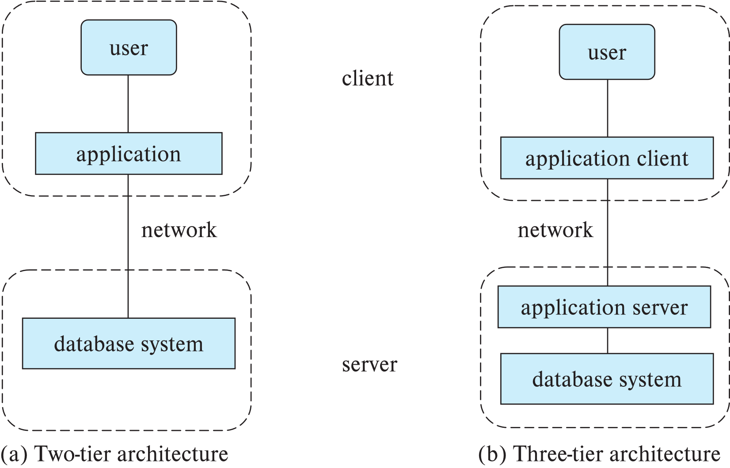
Database Architecture
Database applications are usually partitioned into two or three parts
Two-tier architecture -- the application resides at the client machine, where it invokes database system functionality at the server machine
Three-tier architecture -- the client machine acts as a front end and does not contain any direct database calls.
The client end communicates with an application server, usually through a forms interface.
The application server in turn communicates with a database system to access data.

Slide 36
1.8 Database Users and Administrators
Four categories of users
with different purposes and access modes

Slide 37
Database Administrator/DBA
A person who has central control over the system is called a database administrator (DBA). Functions of a DBA include: DBS运维
Schema definition
Storage structure and access-method definition
Schema and physical-organization modification
Granting of authorization for data access
Routine maintenance
Periodically backing up the database
Ensuring that enough free disk space is available for normal operations, and upgrading disk space as required
Monitoring jobs running on the database
云（原生）数据库降维打击DBA

Slide 38





1.9 History of Database Systems
1950s and early 1960s
Data processing using magnetic tapes for storage
Tapes provided only sequential access
Punched cards for input
Late 1960s and 1970s
Hard disks allowed direct access to data
Network and hierarchical data models in widespread use
Ted Codd defines the relational data model, in 1971
win the ACM Turing Award for this work
IBM Research begins System R prototype
UC Berkeley (Michael Stonebraker) begins Ingres prototype
Oracle releases first commercial relational database
High-performance (for the era) transaction processing
Charles W. Bachman
Turing Award 1973
主持设计开发最早的网状数据库管理系统IDS
Ted Codd
Turing Award 1981
关系数据库之父
James Gray
Turing Award 1995
数据库事务/完整性/安全性，SQL Server 7.0
对现代数据库系统底层的概念与实践所做出的基础性贡献；
SQL Server/Sybase奠基人
Michael Stonebraker
Turing Award 2014

Slide 39
History of Database Systems (Cont.)
1980s:
Research relational prototypes evolve into commercial systems
SQL becomes industrial standard
Parallel and distributed database systems
Wisconsin, IBM, Teradata
Object-oriented database systems
1990s:
Large decision support and data-mining【数据挖掘】 applications
Large multi-terabyte data warehouses【数据仓库】
Emergence of Web commerce
2000s
Big data storage systems
Google BigTable, Yahoo PNuts, Amazon,
“NoSQL” systems.
Big data analysis: beyond SQL
Map reduce and friends
2010s
SQL reloaded
SQL front end to Map Reduce systems
Massively parallel database systems
Multi-core main-memory databases
Recent years
数据仓库/数据中台/数据集市/数据湖
云原生数据库

Slide 40
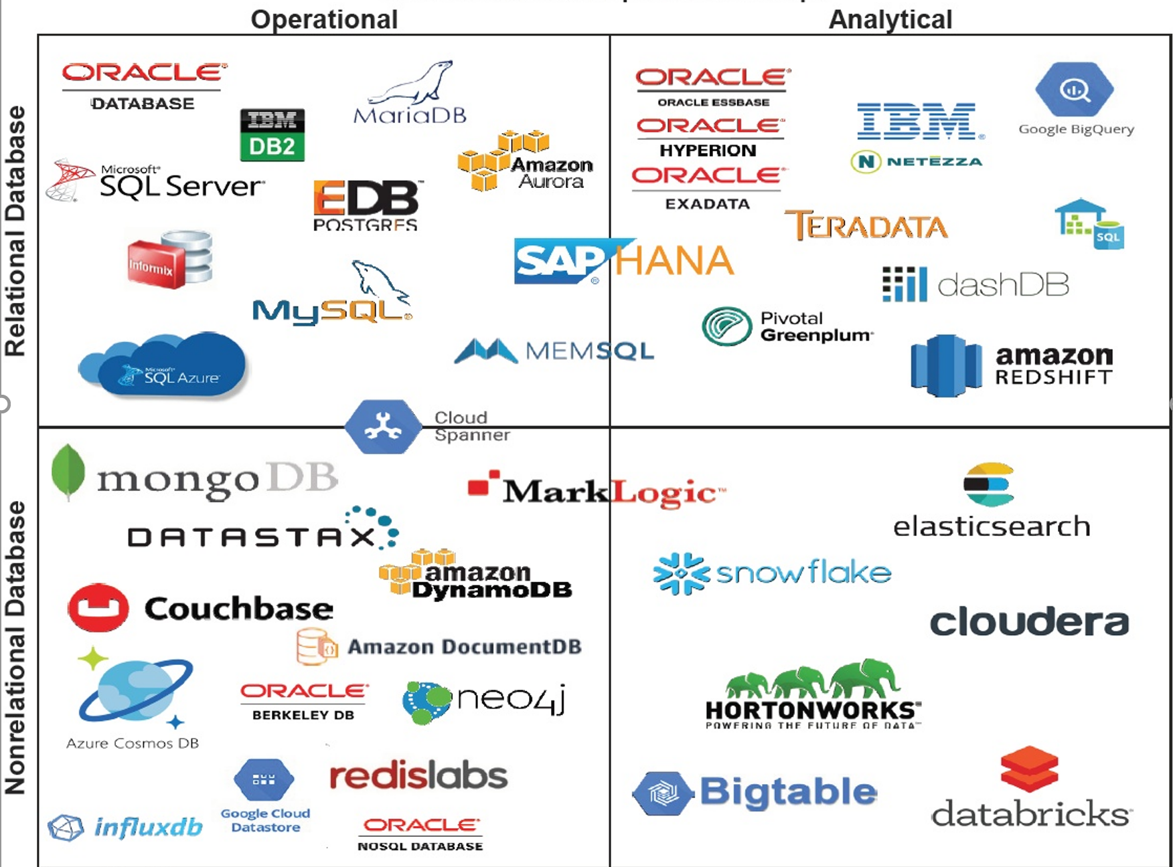
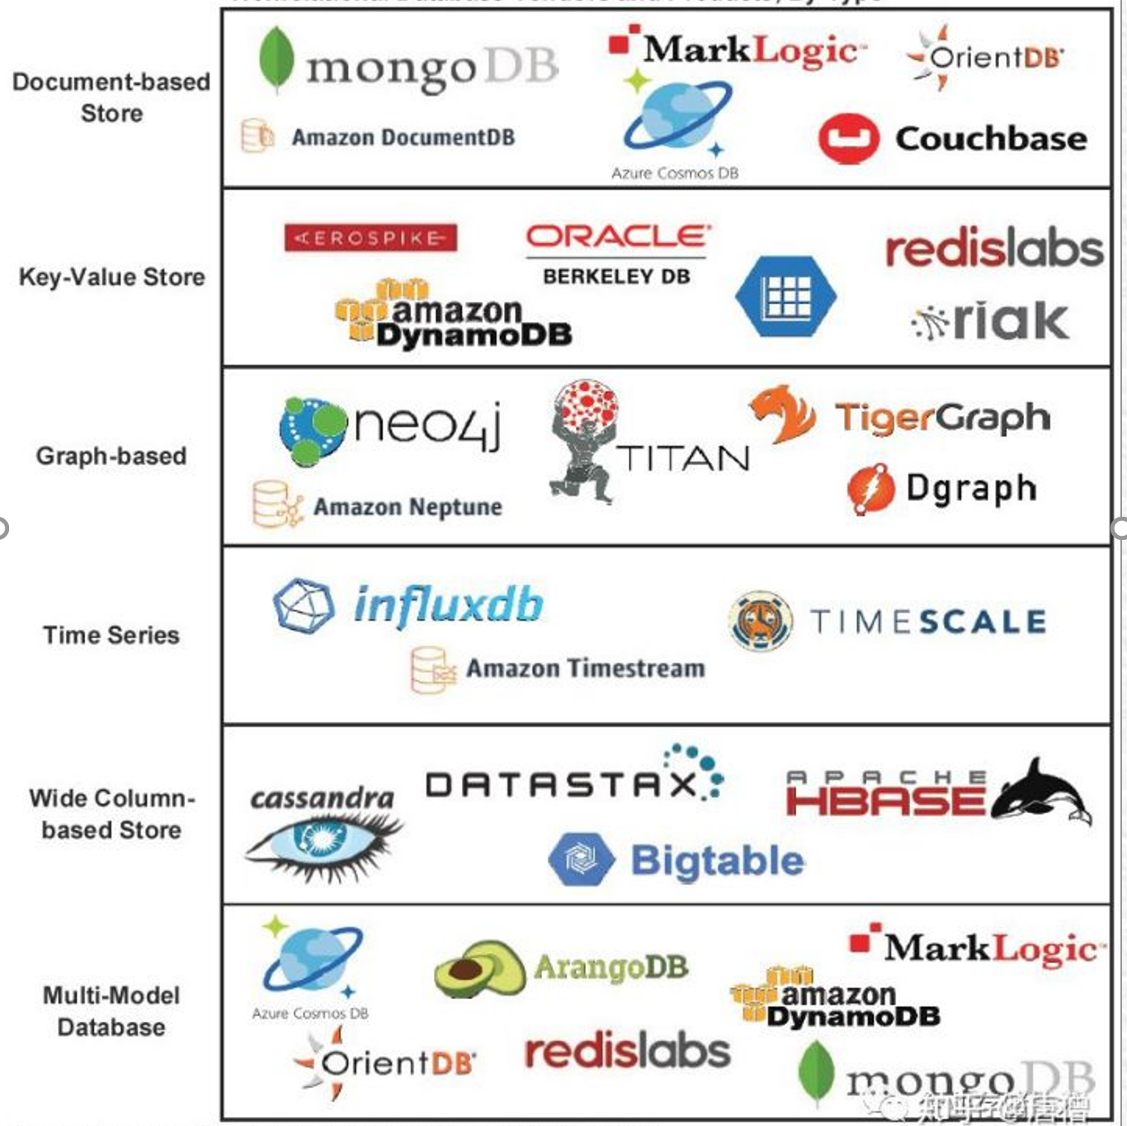
1.10 Database Products&Markets

Slide 41
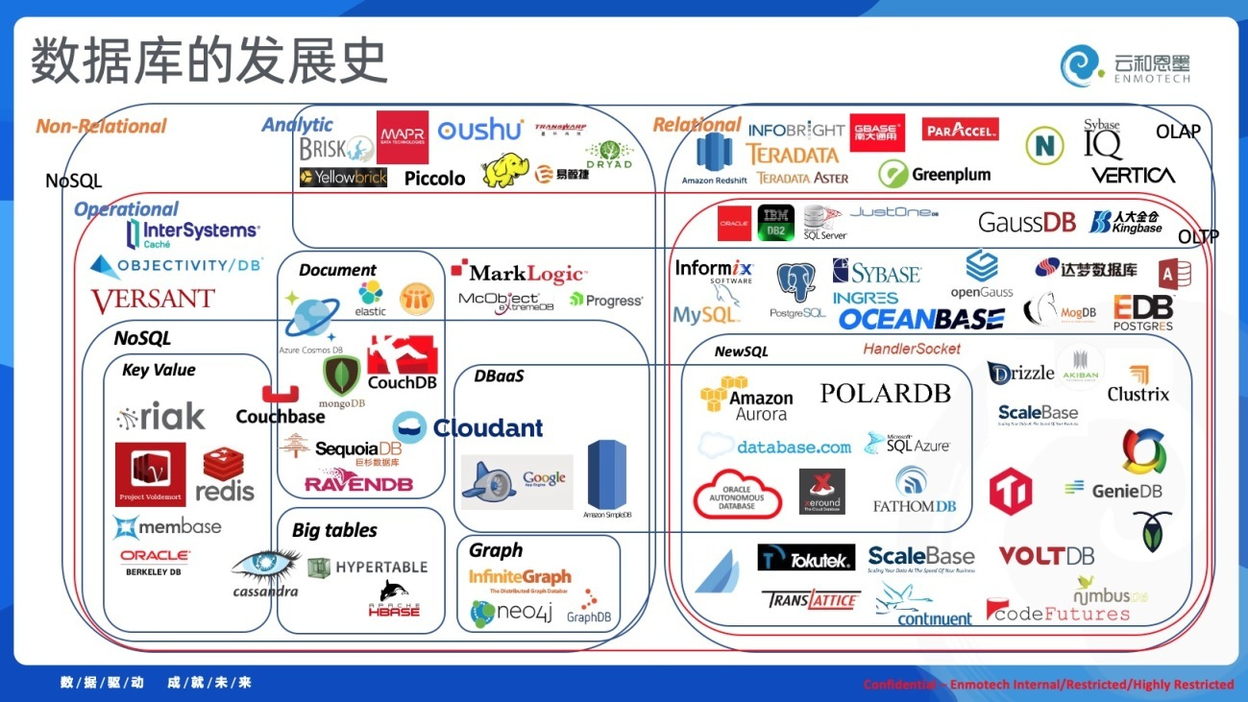

Slide 42
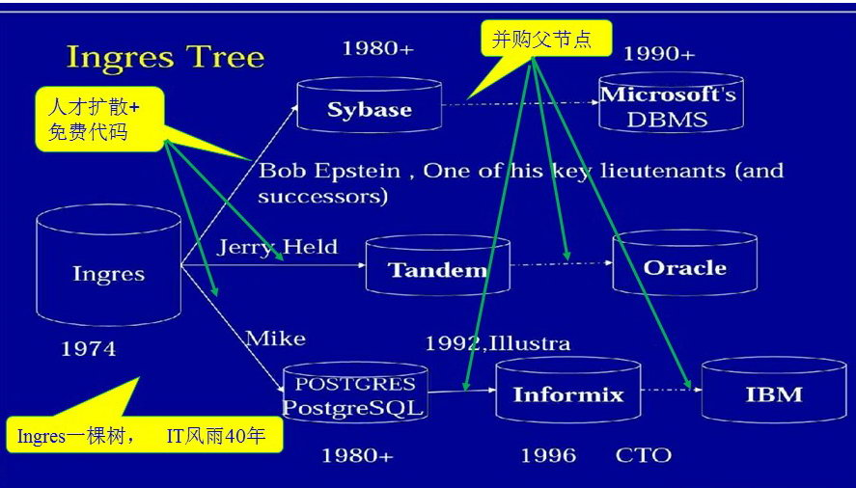
Ingres and Its Successors

Slide 43
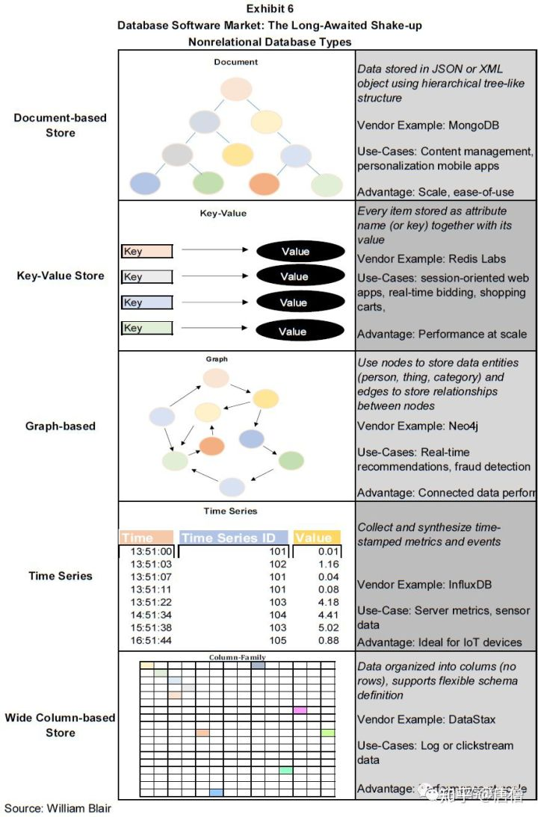
Database Products&Markets
Relational databases dominates markets
New types of non-relational (NonSQL) databases are emerging
document
key-value
graph
time series
main-memory
column-stored
multi-model

Slide 44
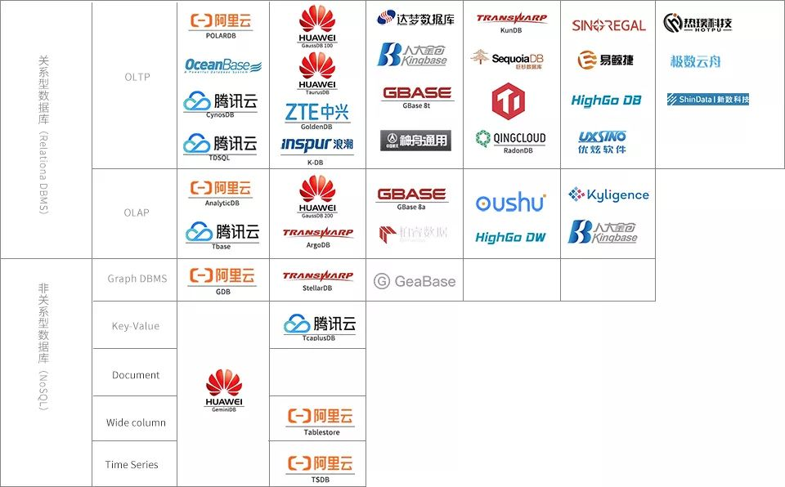




国产数据库：机遇与挑战

Slide 45
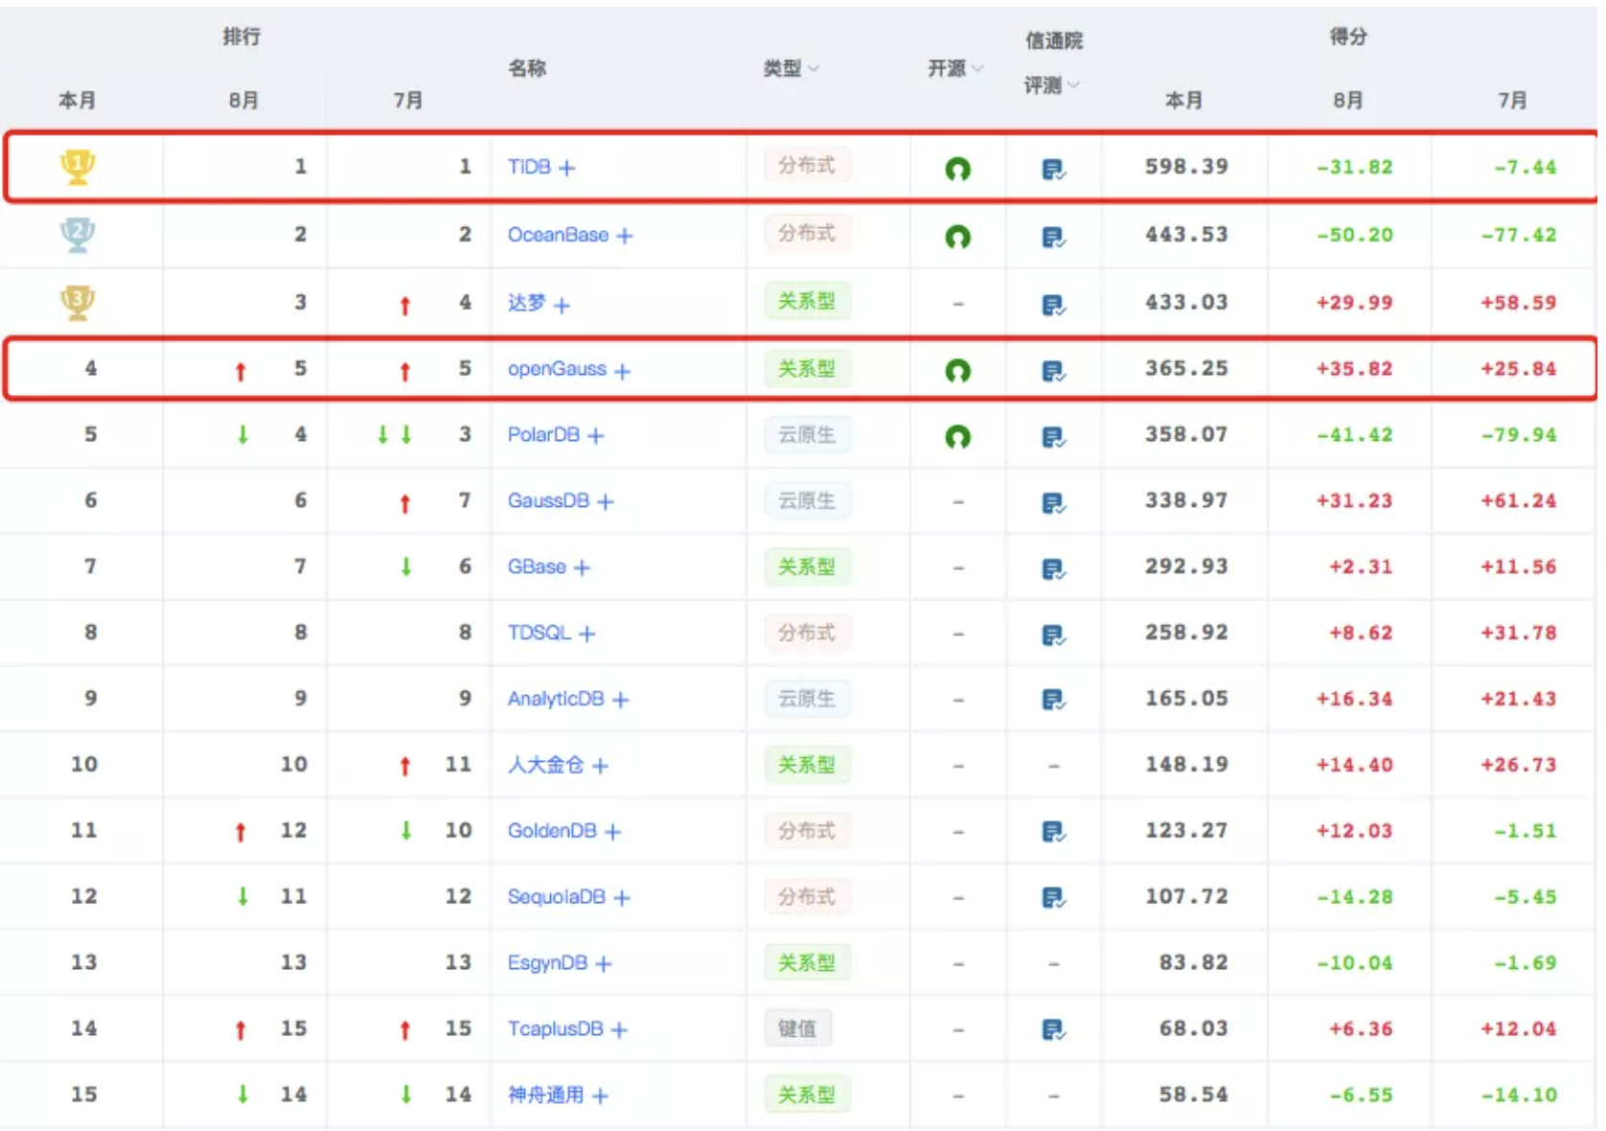
排行榜
2021年9月国产数据库排行榜

Slide 46
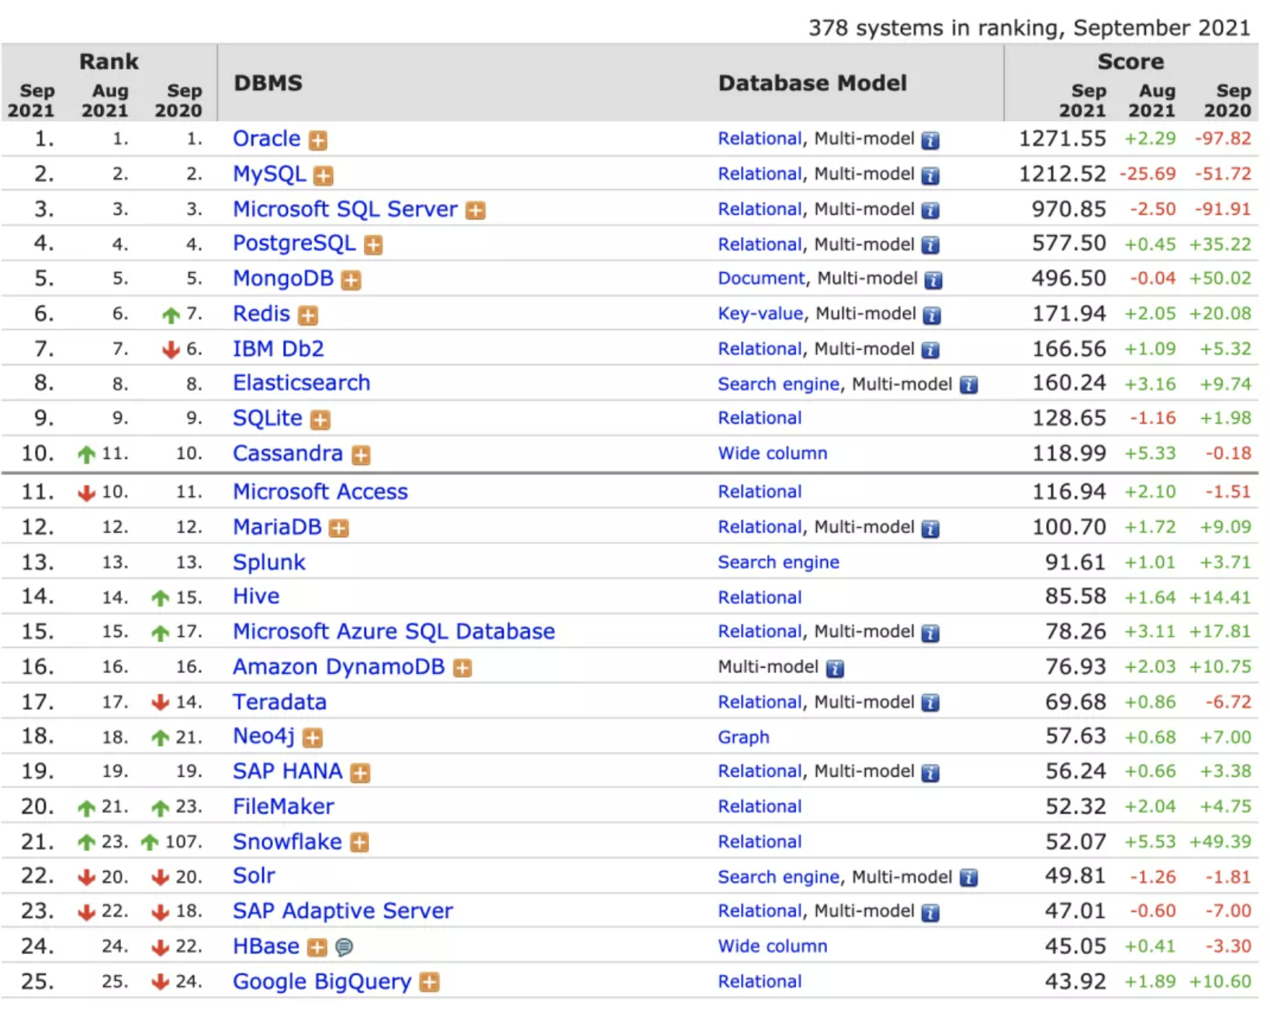
2021年9月数据库流行度排行榜：DB-Engines Ranking

Slide 47
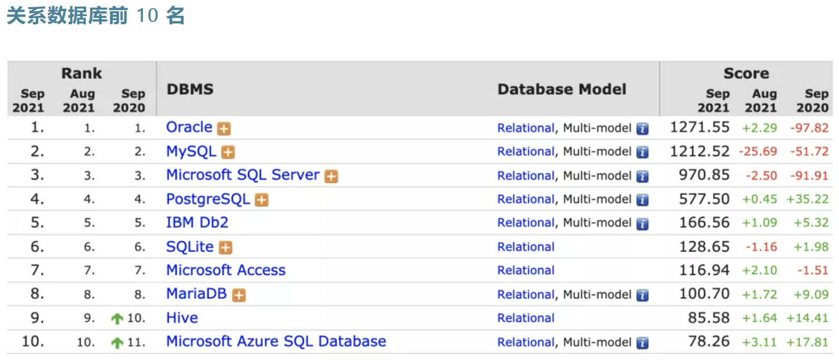
2021年9月数据库流行度排行榜：DB-Engines Ranking

Slide 48
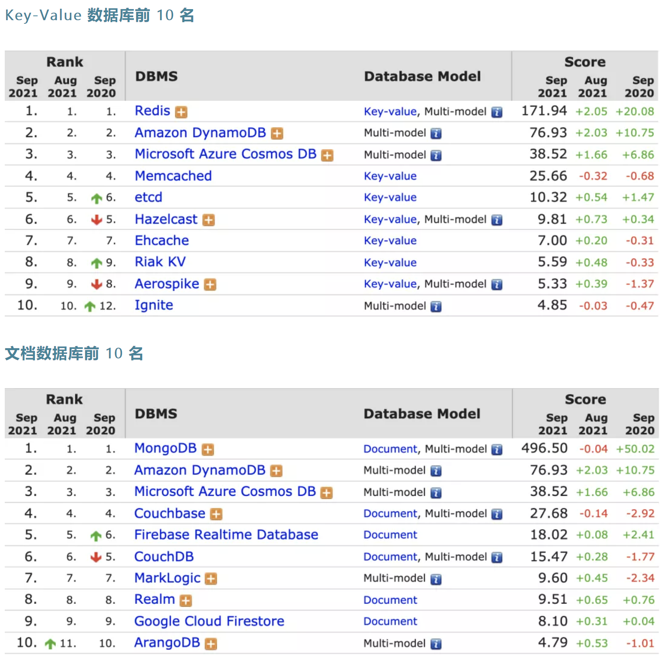
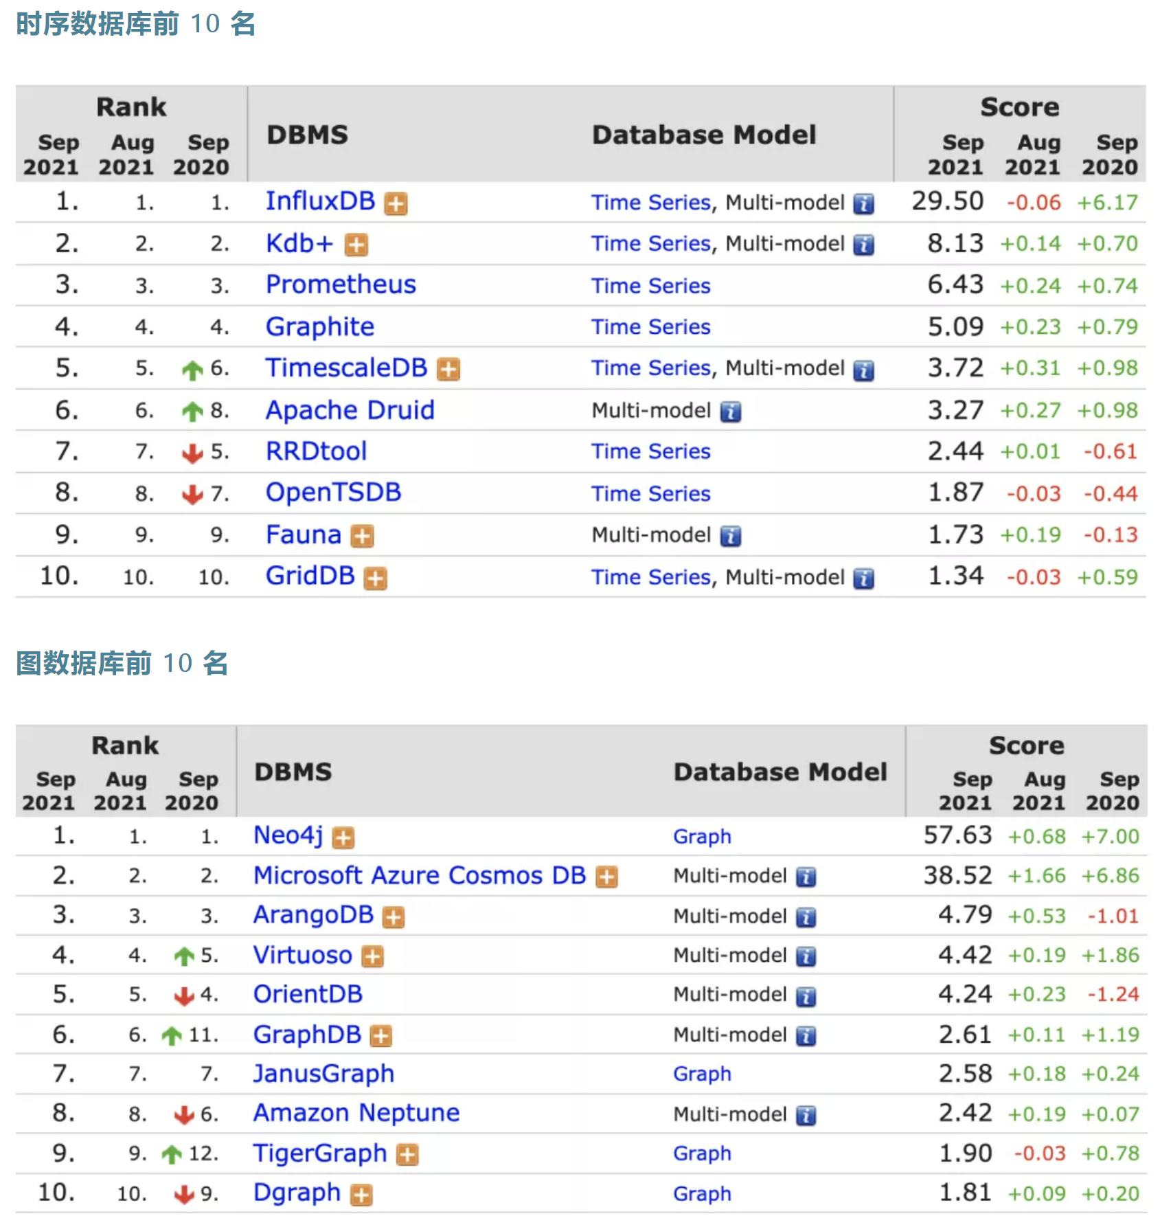
2021年9月数据库流行度排行榜：DB-Engines Ranking

Slide 49
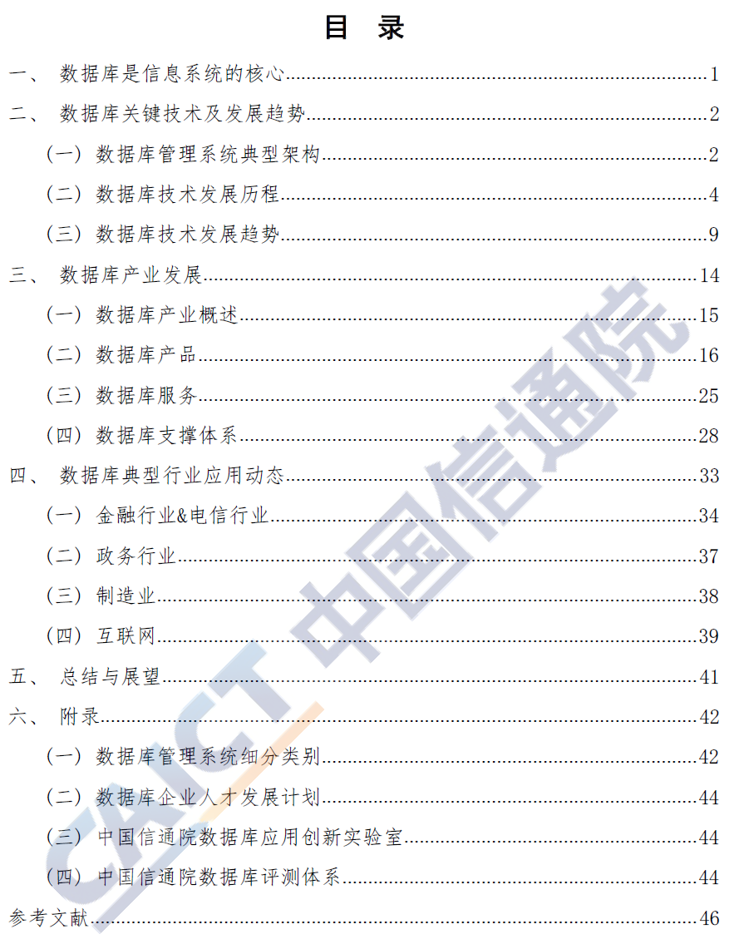
2021年数据库发展研究报告-CAICT中国信通院
【注：直接点击打开文档】

Slide 50
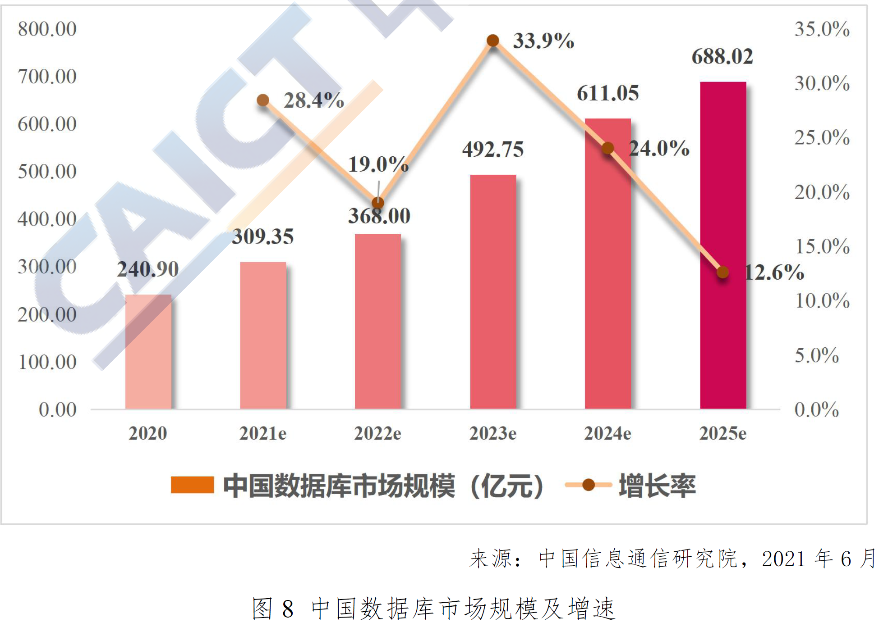
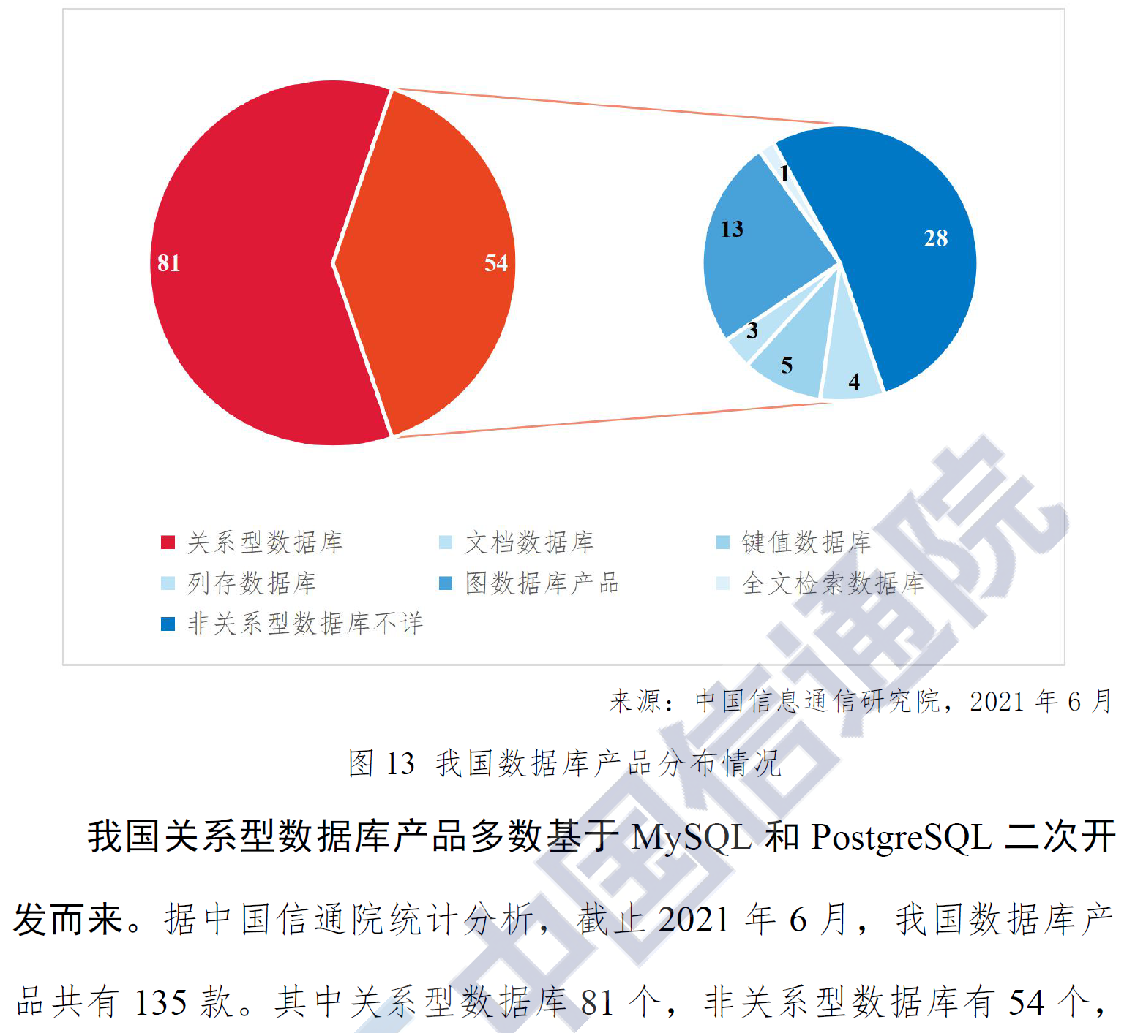
2021年数据库发展研究报告-CAICT中国信通院

Slide 51

Thanks for your attention

